Slide 1
Support for Marriage of an Orphan Girl
Keerthana Kid – Manjula

Slide 2
Bio-data of both Bride & Groom
Name of Bride: Manjula, 19 years of age
Found in Kurnool Railway station. Orphan. Has no one.
Since 12 years – she is with Keerthana
Name of the groom: Rajesh
Town: Adoni
Seshu Tiffin Center
3 boys – He has 1 elder & younger brother
Only mother. Her name is Veeramma. Father is Bhaskar; passed away.

Slide 3
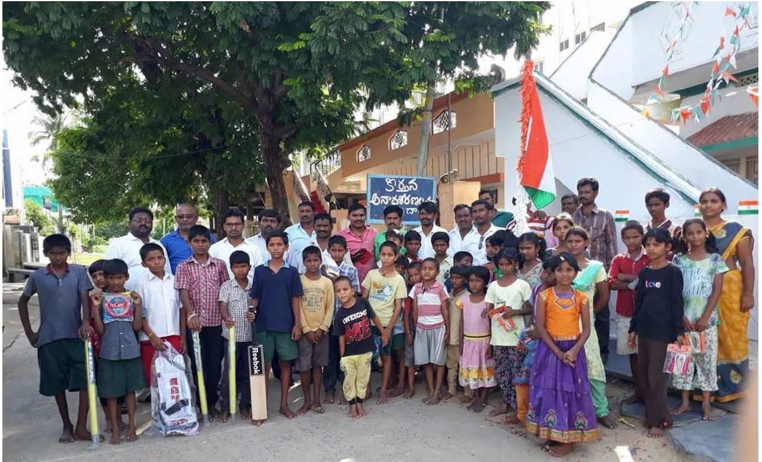
Encircled in Group photo

Slide 4
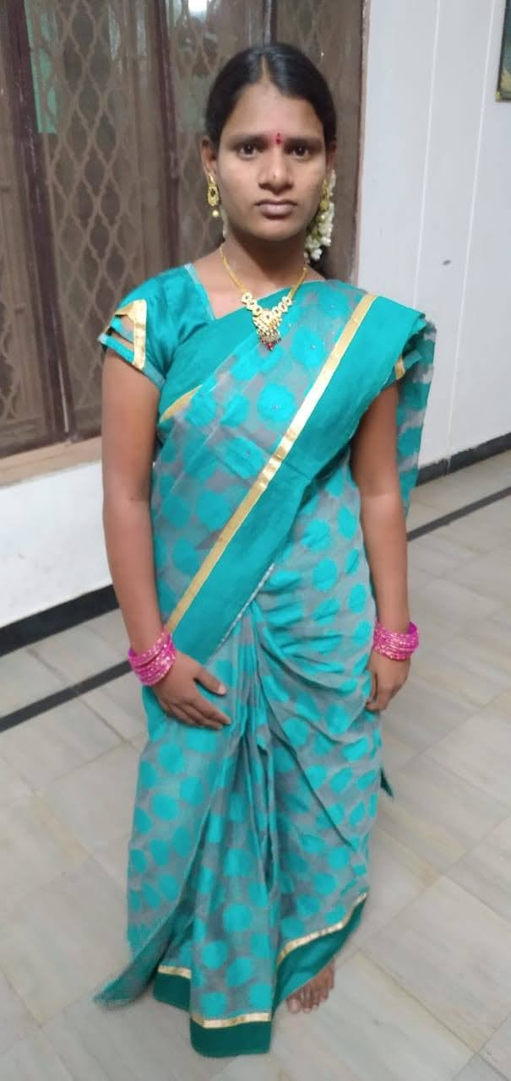
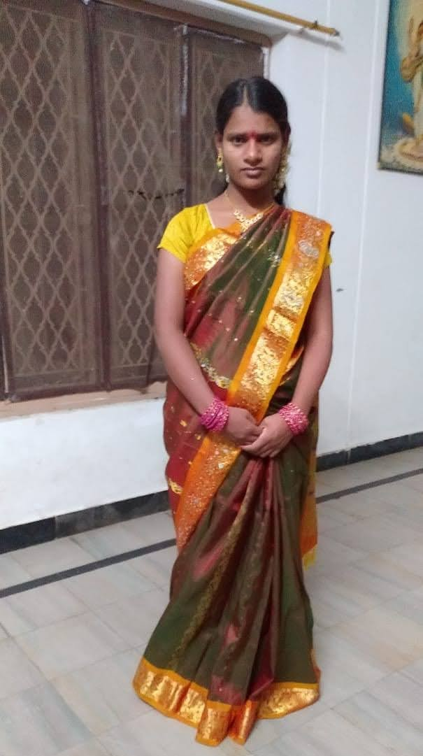
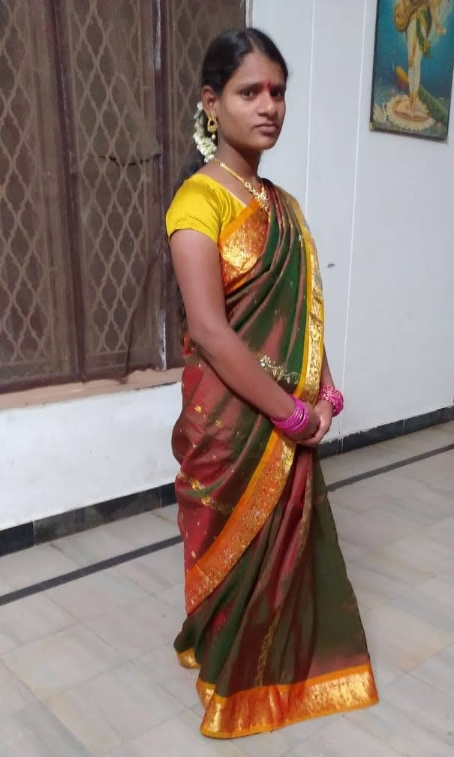
Manjula – Orphan Girl - Bride

Slide 5
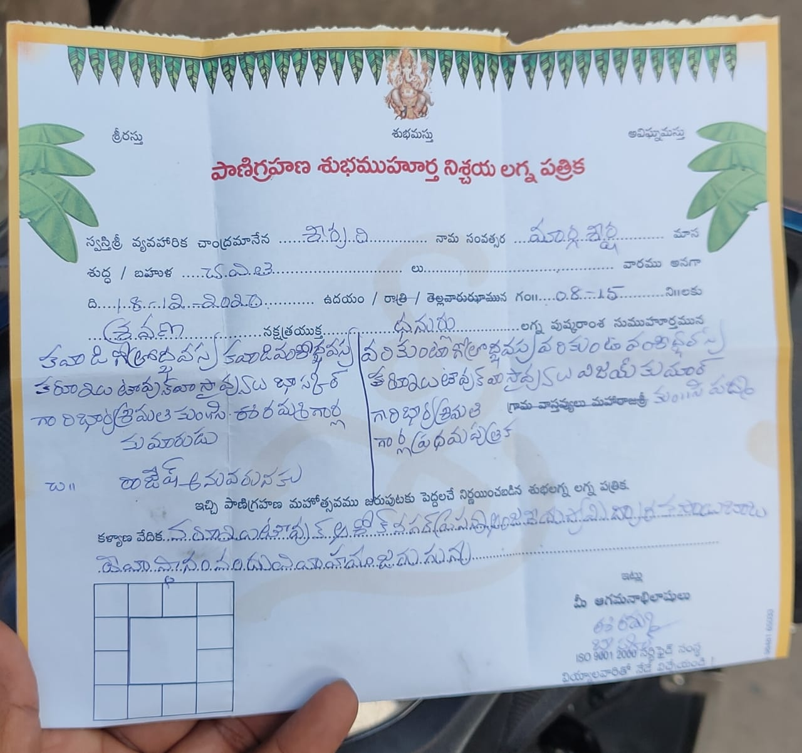
Lagna Pathrika

Slide 6
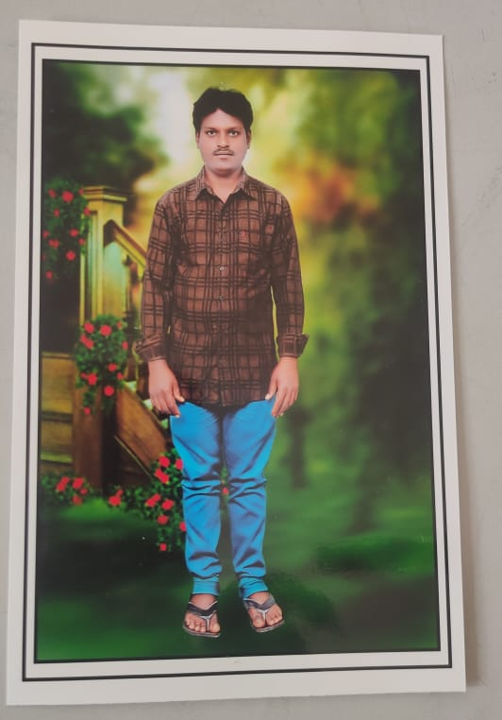
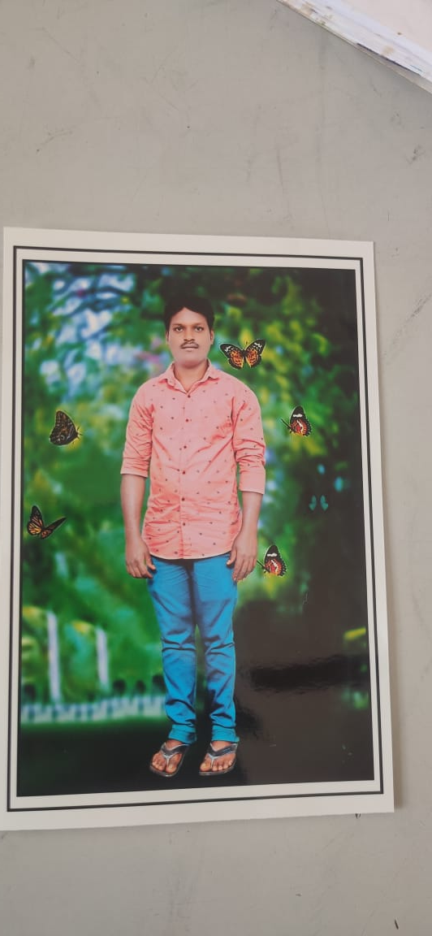
Rajesh – Bride Groom

Slide 7
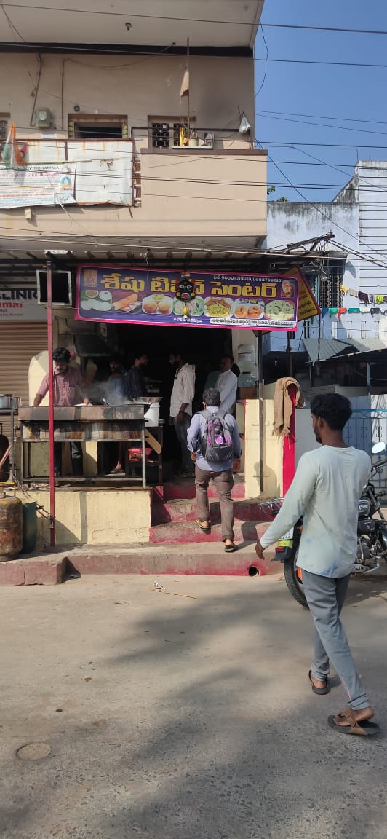
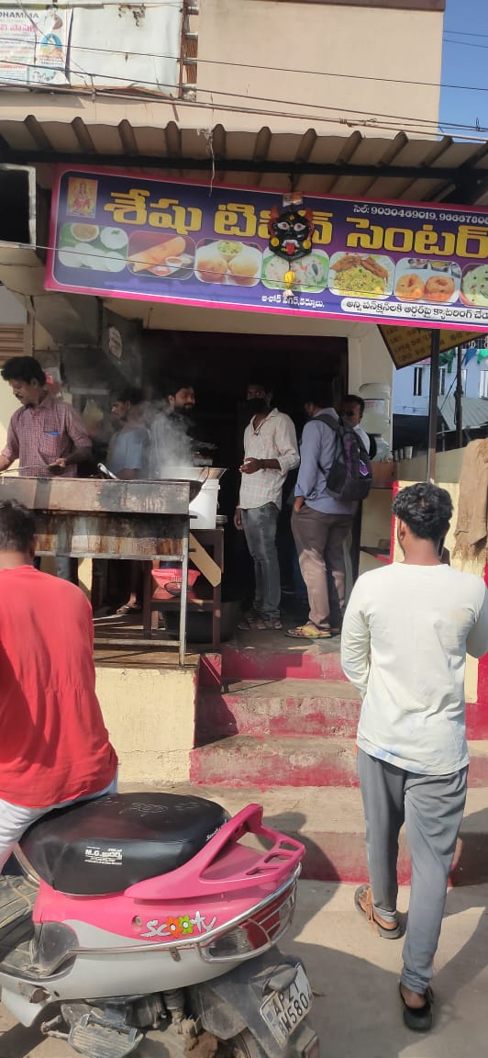
Seshu Tiffin Center

Slide 8
Details of Marriage & Support sought
Agreed to give for Marriage
Vendi pattilu – already got by Keerthana Founder
Kuttu machine – already got by Keerthana Founder
Kammalu – ½ thola – 5 grams
Thali bottu – 1 billa – Not sure how much
Clothes – around 5 pairs for girl
Miscellaneous expenses of 10K
Marriage is on 18th Dec (this Friday) and he gave me all these details only yesterday. Blue items are the ones he is looking for support. We need to decide today. Sorry for short notice.

